Slide 1

ETICS presentation on the 100 years anniversary celebration of CEBEC
Bence Thurnay - Secretary General of ETICS Aisbl
https://www.etics.org/

Slide 2





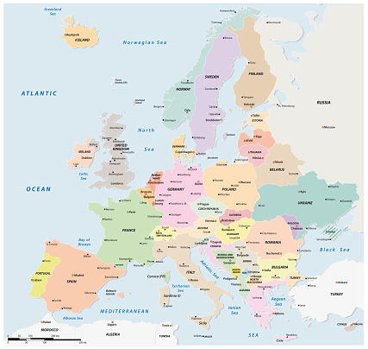




















27 Test houses created ETICS AISBL, to administer several certification schemes

Slide 3
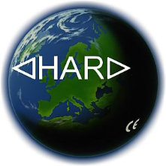





ETICS – European Testing Inspection and Certification System
The HAR mark is an agreement on the use of a common marking for cables and cords complying with the harmonised specifications. (1974)
The CENELEC Certification Agreement (CCA) is a European agreement on mutual recognition of test results. (1983)
The CCA-EMC agreement certifies products as to their electromagnetic compatibility. (1998)
ENEC is the European mark for electrical products that demonstrate compliance with
European EN standards. (1992)
ENEC+ is the European mark that certifies the initial performance of LEDs and other luminaires. (2014)
The CIG system is the newest agreement, a common tool and methodology for the
supervision of manufacturer locations producing type tested products in a serial production. (2020)

Slide 4
Historical overview of standardisation, testing and certification
To understand standardisation, you need to understand the regulatory frameworks that have been and are still regulating the sales of electrical products.
In most countries in Europe, there were mandatory certification requirements to be met before an electrical product could enter the market
In each country there was one appointed certification body, owned or appointed by the country’s government.
In the 1910’s, two testing and certification bodies from Germany and the Netherlands had formed the Installationsfragekommission (IFK) to collaborate on standardisation. By the end of 1939, the number of members in IFK had risen to 13.
In 1946, based on IFK the CEE (International Commission on Rules for the Approval of Electrical Equipment) was created with 13 members, with an European focus. At the end of the 1940s, the CEE, formed a partnership with IEC (International Electrotechnical Commission), the largest global standardisation organisation in the electrotechnical area.
In 1961 the CEE CB (Certification Body) was formed, with the aim to limit the number of tests to different mandatory European certificates.
1985 was a turning point for European standardisation. The drivers of the CEE, the testing and certification bodies, had given up the previous form of cooperation and standardization has been transferred to CENELEC. The certification branch of the CEE switched to the IEC. A conformity assessment system was created here, the IECEE, which is now one of the largest global certification systems for electrical products.

Slide 5
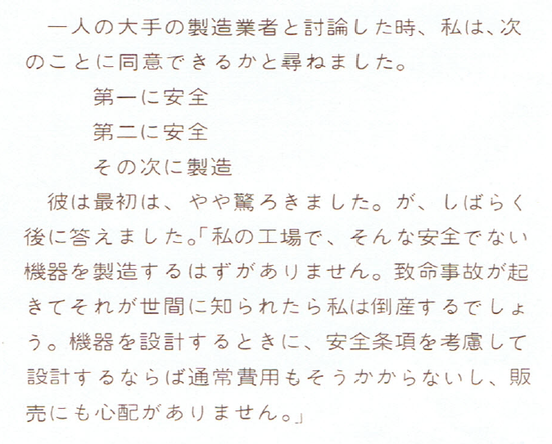
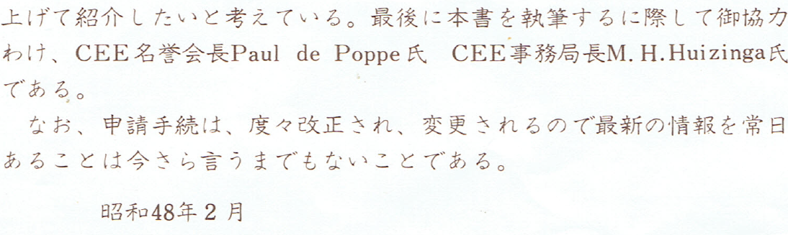
A selected moment from 1973 about an activity of the CEE
My dear colleagues, who respect the past, deposited with me a special study made in 1973, in order to avoid "final" archiving.
In a discussion with a big manufacturer, I asked him if he could agree with me on the following:
1. Safety first
2. Secondly, Safety
3. And then, production
He was at first a little astonished but answered after a while: My firm cannot afford to produce unsafe equipment; just a few fatal accidents, and when they become known, this will ruin my business.
A comprehensive and detailed information on standardisation and the cooperation of testing and certification organisations for the Japanese authorities.
Dated in Showa 48 = European calendar 1973.

Slide 6
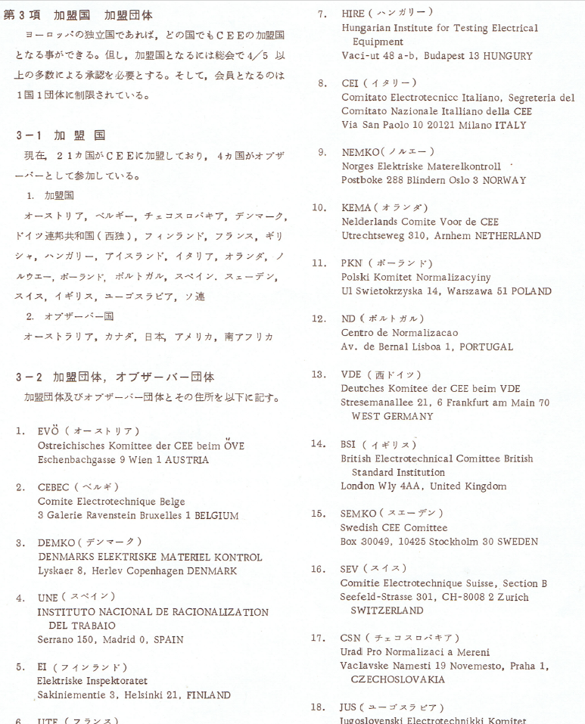
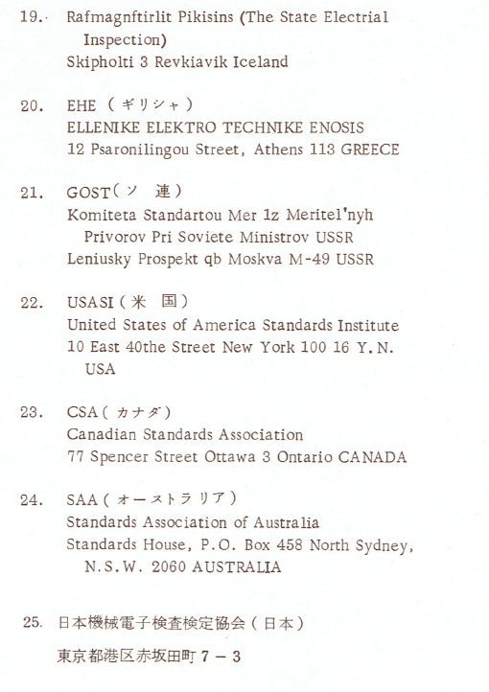
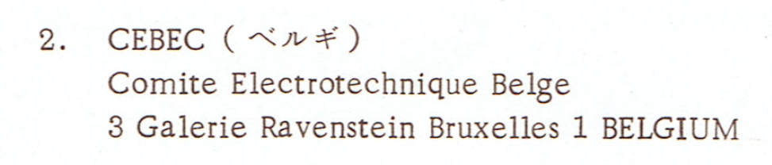
CEE in 1973: already 25 member
21 European
2 American
1 Australian
1 Asian (Japan)

Slide 7
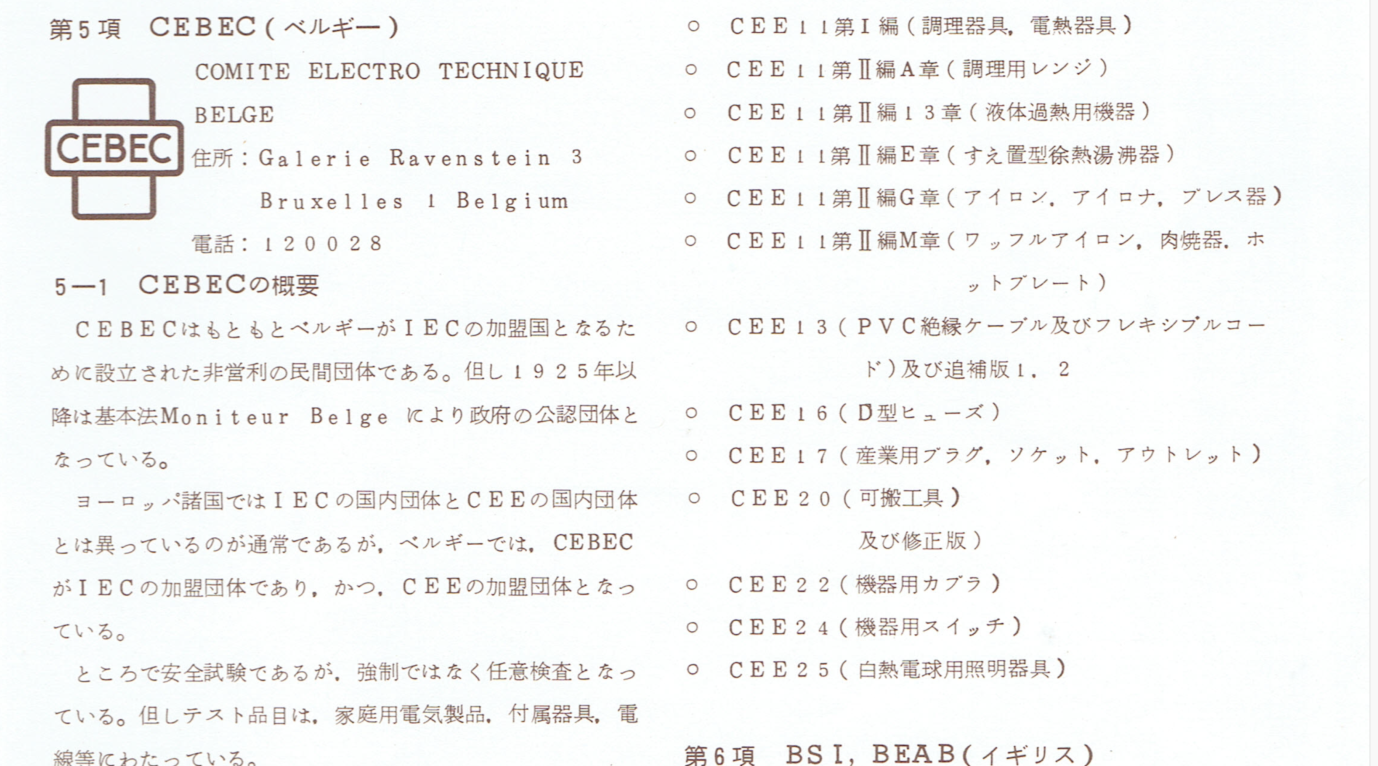
The contributions by CEBEC to CEE documents

Slide 8
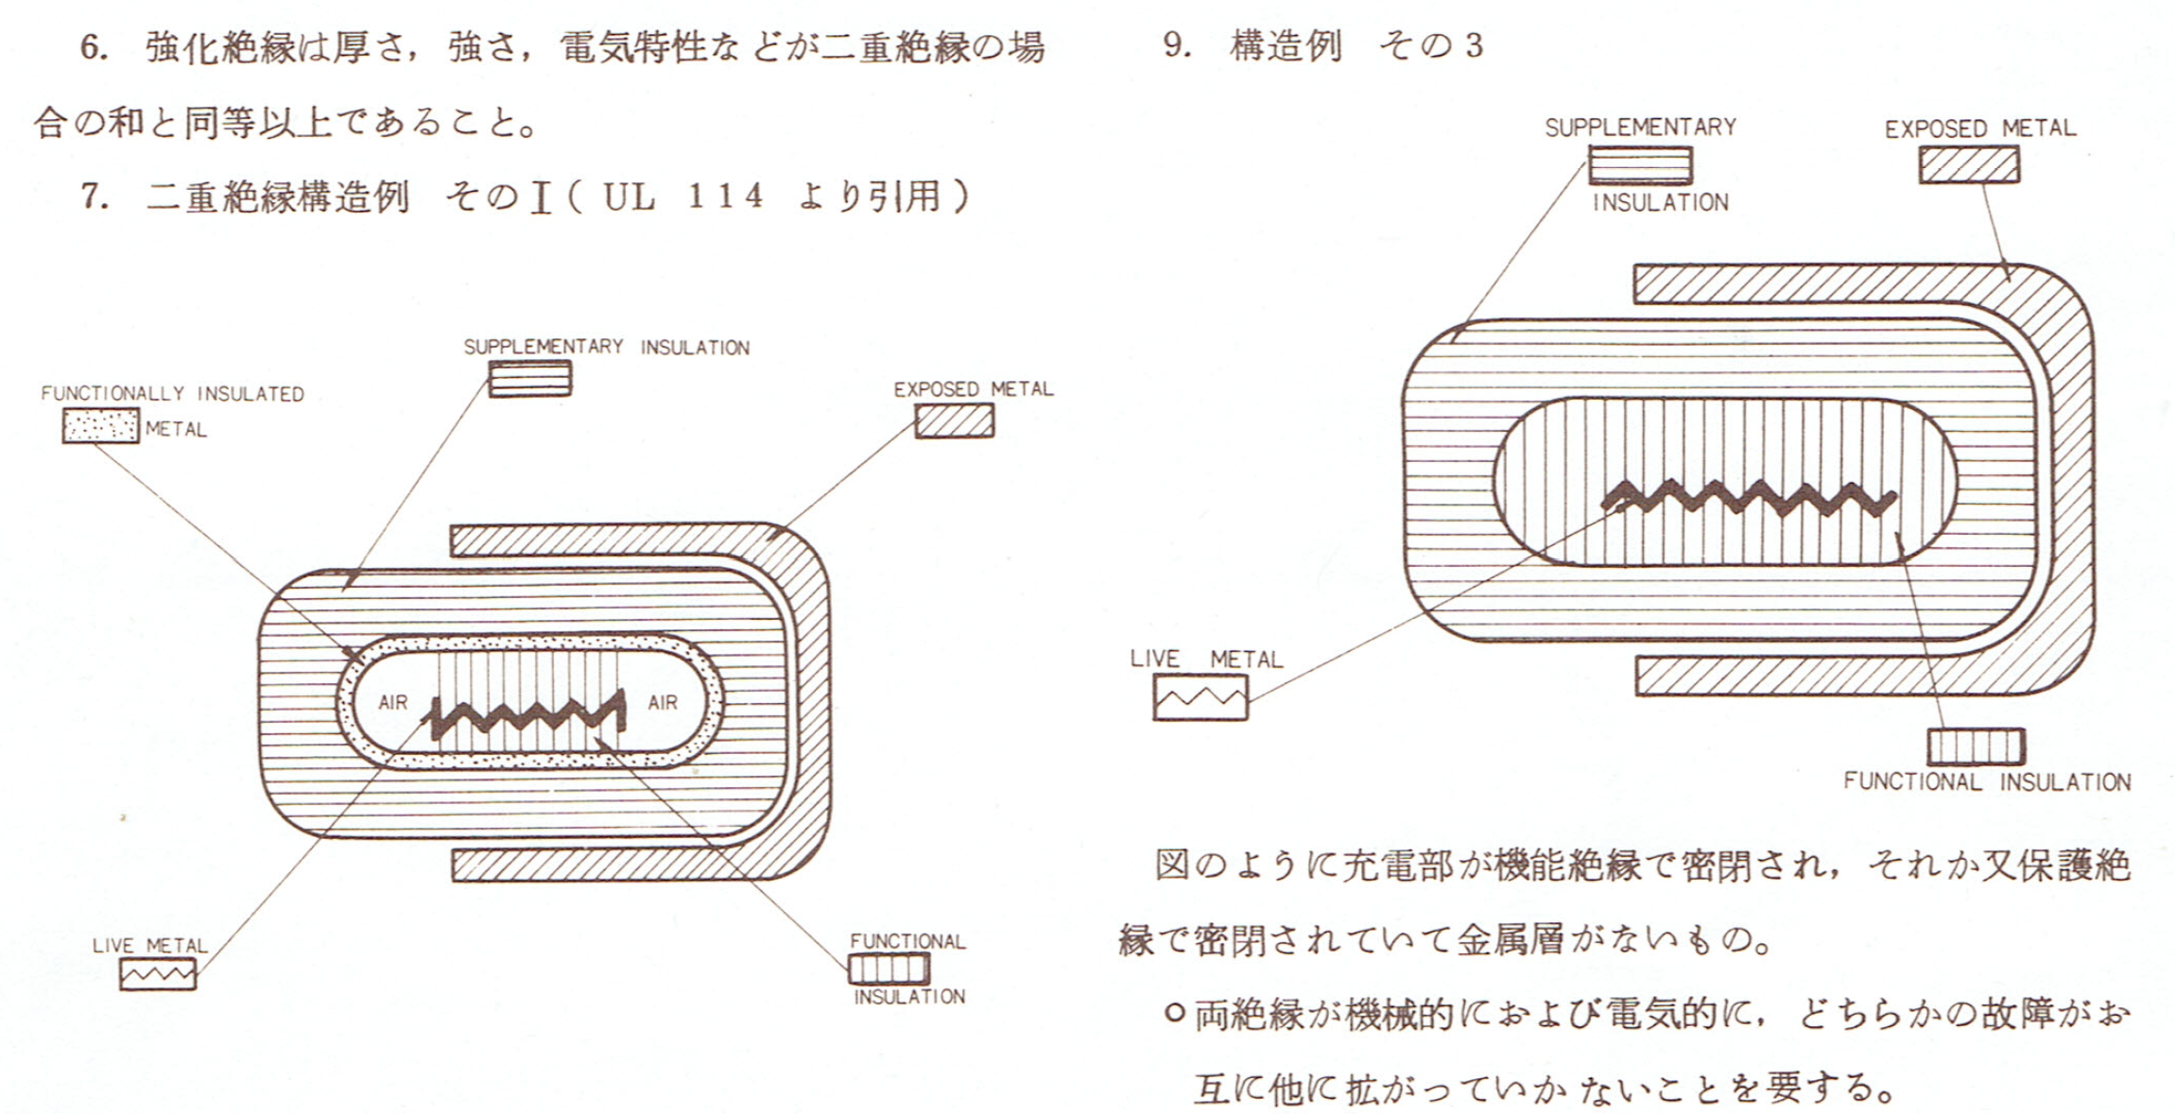
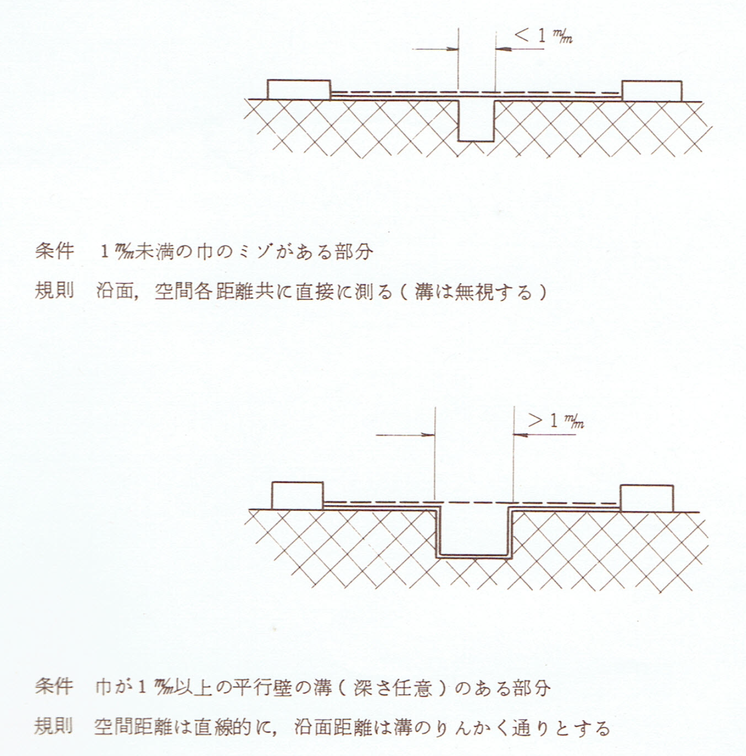
The study explained to the new member from Japan
The basic principles necessary to understand the standards and safety concepts

Slide 9
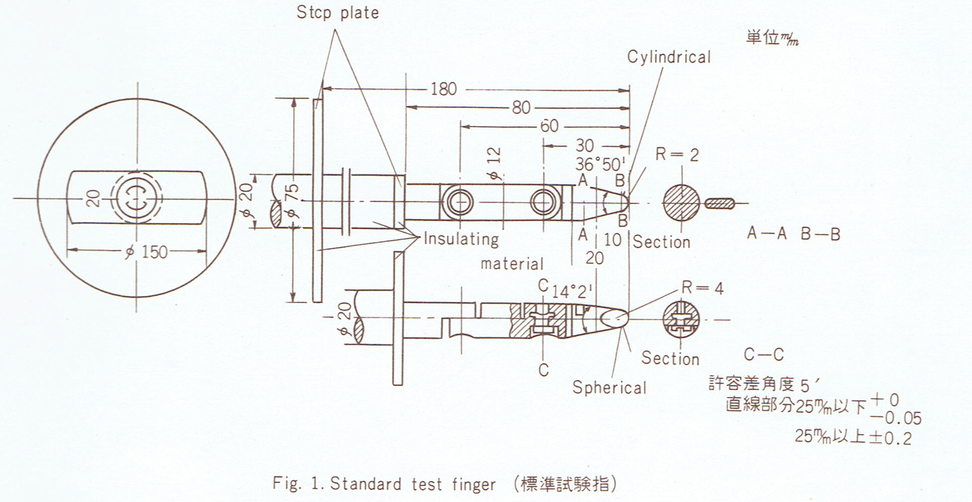
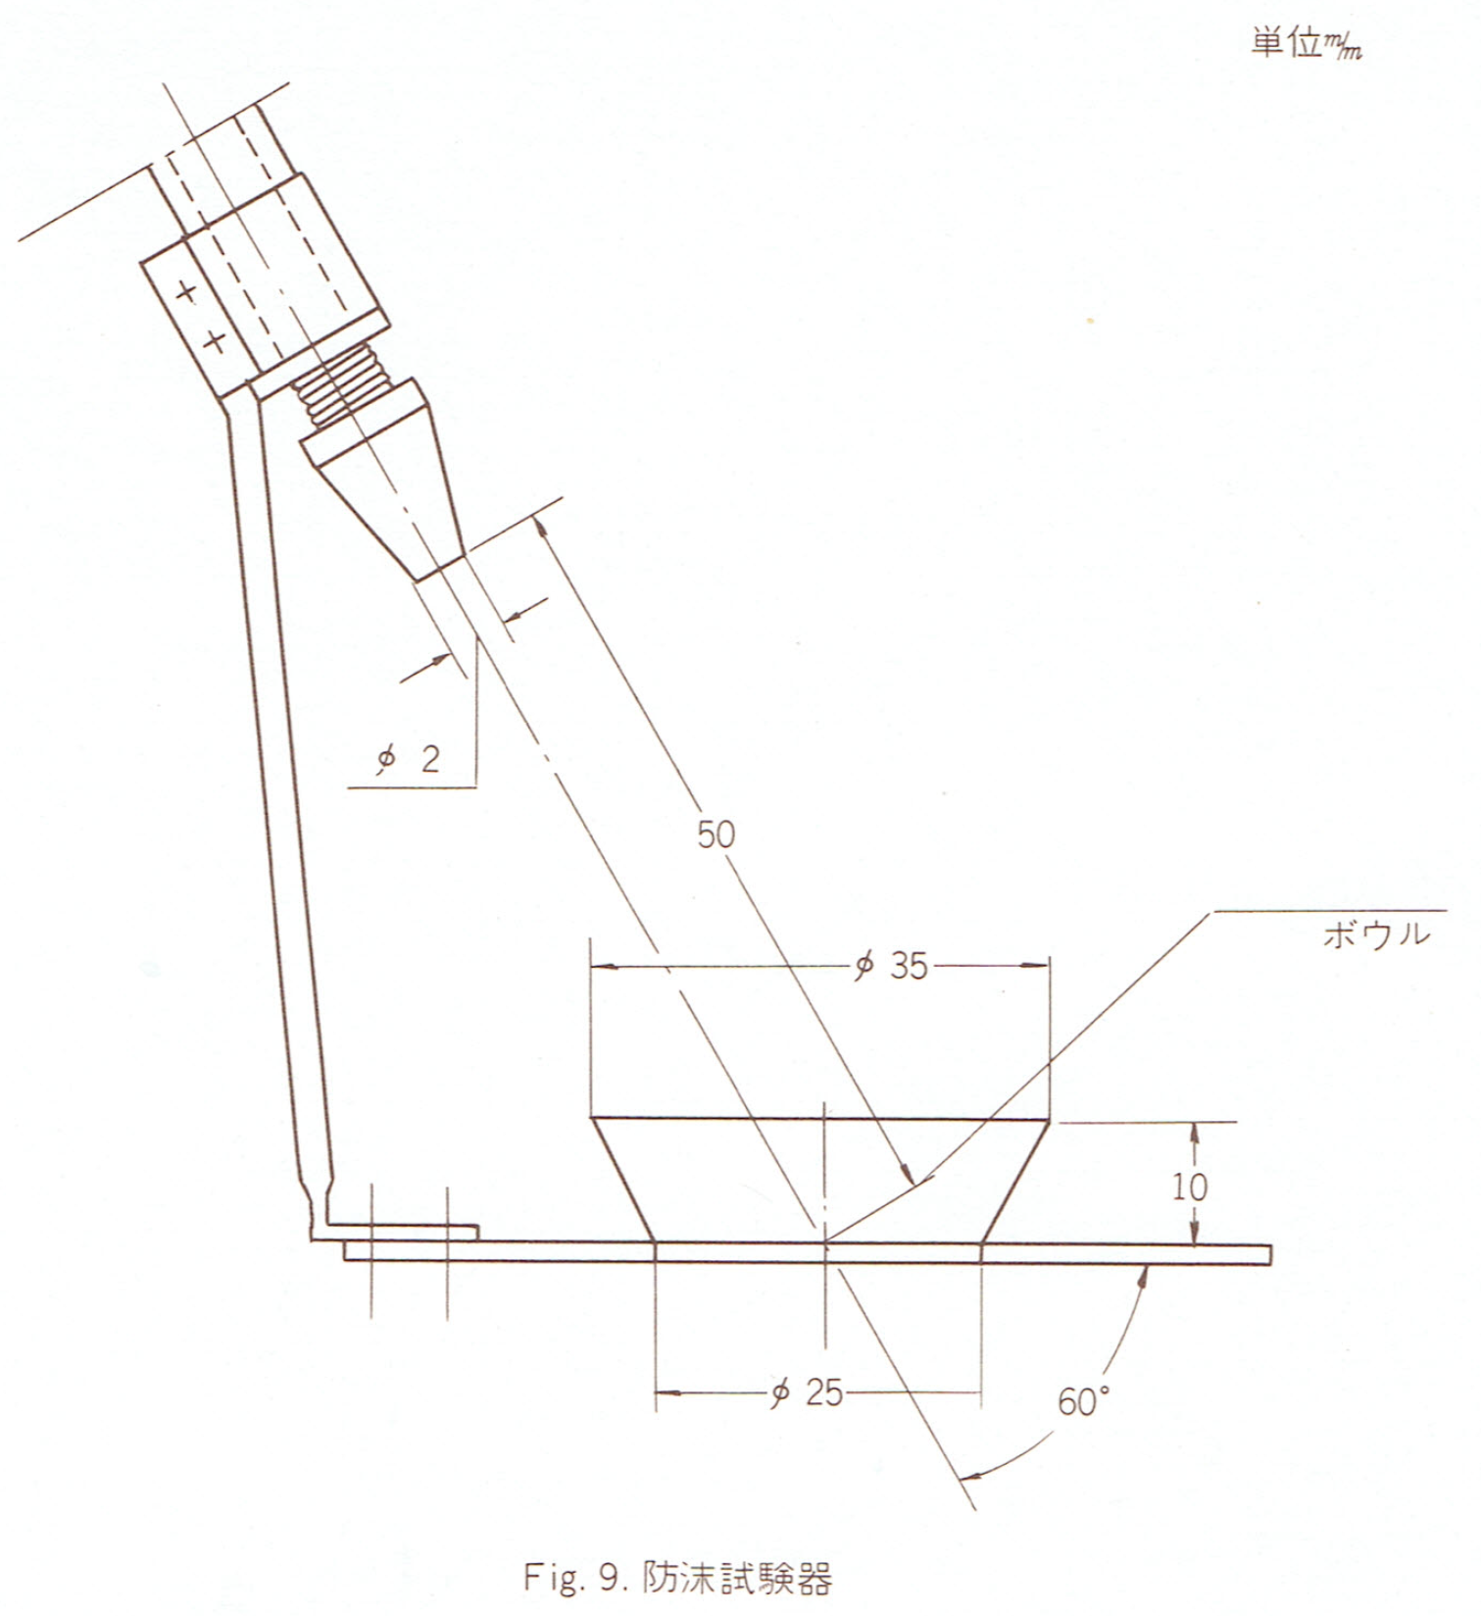
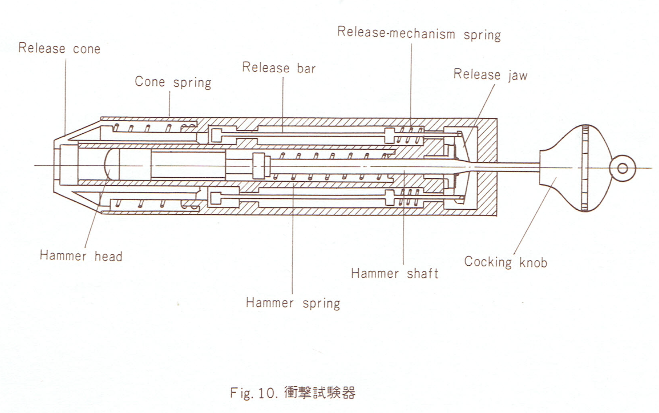
The study explained to the new member from Japan
Special test equipment used in all standard, which define standardised test conditions
Standard finger, if it fits through an opening, can it be touched, are there any dangers?
Hammer - strength of plastic coverings
Water sprinkler - e.g. refrigerators

Slide 10
Comparison of the situation and challenges of the 1970s -80s and the 2020s -30s
Dominant technologies: Electronic equipment of household, radio-television, tools, luminaires
Energy power: 230V AC network
Strong industry production: Europe
Purchasing power: Europe, USA End user
Characteristic of the market: Open to volume growth
Dominating technologies: Digital, IT, Internet, AI The traditional electronic industry do not dominate the technology development
Energy power: 230V AC network Batteries
Local Photo Voltaic generators
DC current network?
Strong industry production: Asia
Purchasing power: still Europe and USA ↑ emerging Asia, South America ↑ communities, shared service provider
Characteristic of the market: The receiving market is saturated in terms of quantity, faster replacement forces continuous purchases

Slide 11
Current developments in the certification schemes of ETICS
The CIG scheme has been opened for members outside of Europe
The ENEC scheme is expanded to handle a new category: batteries
The ETICS members investigate developments in the framework of the European Green Deal
To perform the factory inspections abroad, mainly in Asia, but also in South America and any other emerging areas in the future
Originally with a focus on batteries for emergency luminaires, but in a short time the scope has been extended for other types of batteries
- batteries for scooters
- household equipment
- tools
- toys
Services to be confirmed

Slide 12
We would like to congratulate CEBEC for its dominant role in the field of tests and certifications during its 100-year existence.
We would also like to acknowledge to the audience that it is important that Belgium - users and industry - have a strong and recognised conformity assessment organisation.
Finally, we would like to thank the entire staff of SGS CEBEC for actively participating in the ETICS organisation with significant added value. Be it the Board, strategic working groups, or working groups supporting professional work in the sector. A personal thank you - on behalf of the other organizations of ETICS - to all the participating people of SGS CEBEC.

